Slide 1
Beam reﬁnement and beam tracking using Machine Learning Techniques in 5G NR RAN
Student-
Harshal Patal : hapt18@student.bth.se
Supervisor-
Dr. Hüseyin Kusetogullari: huseyin.kusetogullari@bth.se
Notes:
RAN: radio access network
NR: new radio
My name is harshal patel, i am going to present my thesis named ”beam refinement and beam tracking using ML techniques in 5G NR RAN” supervised by Dr. Hyseuin.

Slide 2
Contents
Introduction
Objective
Method
Machine Learning
Data
Simulation
Result
Notes:
This is the agenda for the presentation
INTRO: Since the thesis is based on 5G technology, we will get to know some concepts related to that.

Slide 3
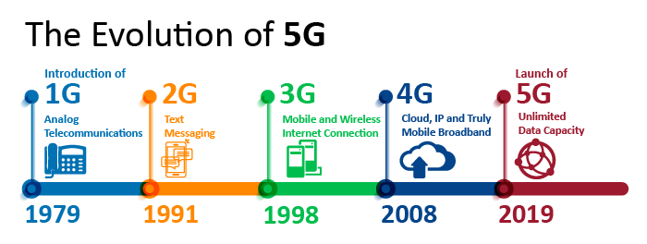
Notes:
Over the past several years, the massive growth is observed in the field of communication. With increasing population, more and more people are connecting and sharing information with each other. Demanding higher rate of data transmission or throughput.
Bandwidth refers to the theoretical rate of speed that data on your network can travel, which is probably a speed you won't see very often. Throughput is the actual rate of speed that data on your network travels.
Throughput = total good units produced / time. [Mbits/seconds]

Slide 4
3rd Generation Partnership Project (3GPP)
Unity of organizations
Defines the protocol
Notes:
3rd Generation partnership project
Unity of organizations which develop protocols for mobile telecommunications.

Slide 5

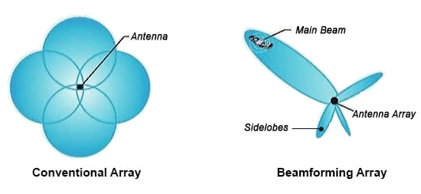
Beamforming
Notes:
LHS image antenna sending signal in all directions
But in 5G beamforming is done
Beamforming: Beamforming is a signal processing technique used in (5G) sensor arrays for directional signal transmission or reception
Benefits :High strength and range
Downside: side lobes are formed.
impact of Side lobes in further slides.
UE: user equipment
beamforming boosts cell range and capacity. That means mobile device users get stronger, clearer signals

Slide 6
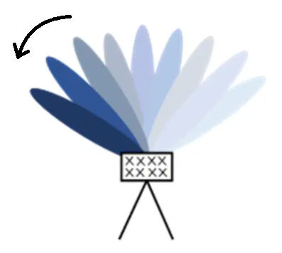
Beam sweep procedure
Notes:
Beam sweep: Beam Sweeping is a technique to transmit the beams in all predefined directions in a burst in a regular interval.
//Everything is happening in 3D, but for the sake of experiment, only 2D scenario is considered.

Slide 7
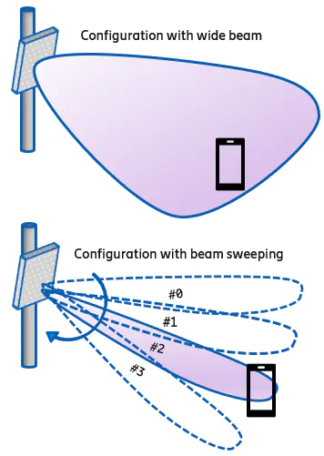

Terminologies
Base station
Notes:
LHS: Base station and UE ’(user equipment)
Above shown is a wide beam generated from a BS. Responsible for connection establishment between UE and BS.
Below that is the WB is further finely divided into narrow beams. These beams are responsible for data transmission between the UE and the BS

Slide 8
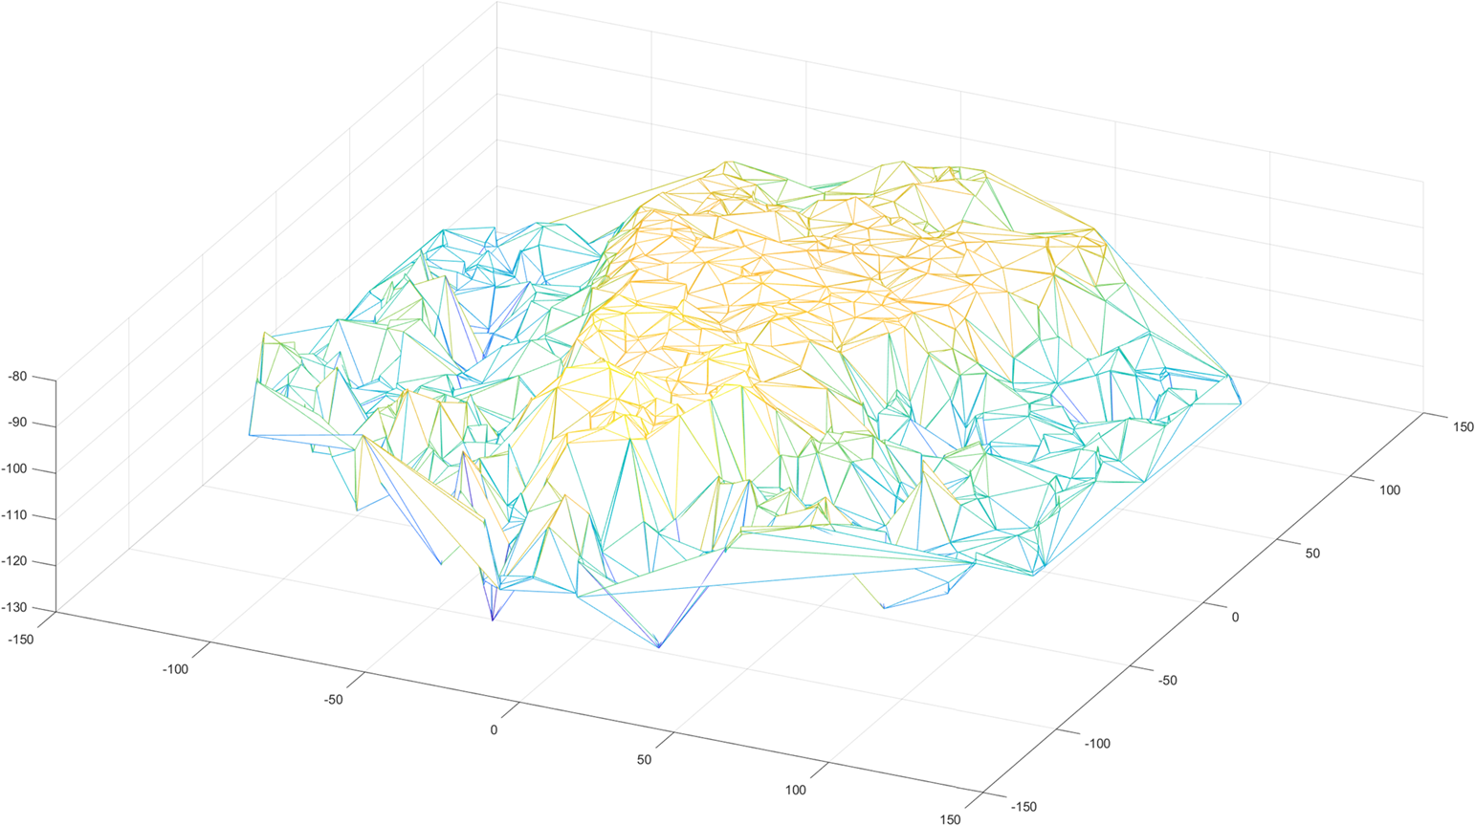
Method: Wide Beam simulation
Notes:
3Dimentional depiction of a wide beam shown in yellow, simulated inside the simulator.

Slide 9
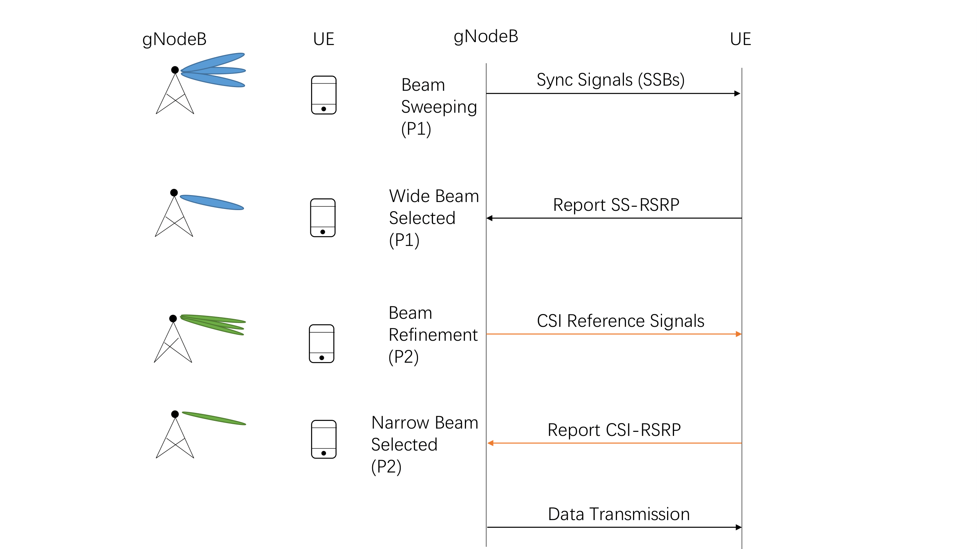
3GPP Baseline
Notes:
Standard 3GPP algorithm is considered baseline for the thesis.
SSB: synchronised signal block (wide beams)

Slide 10
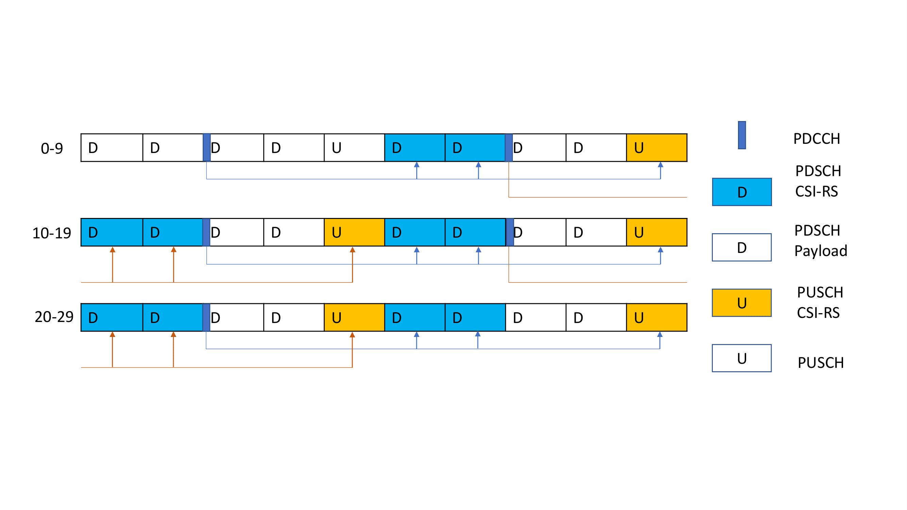
Problem addressed
Time Division Duplex pattern
Notes:
Time division duplex pattern.
CSI-RS: channel state information – reference signal
In 3GPP, Tansfer of data takes place using TDD pattern
Here, for selecting the narrow beam for a user, a report is sent from the user to the BS having a list of top narrow beams for that user. That list is scheduled in the time division duplex slot . This list that is sent uses some scheduling slots (slots) which could have been used for data transmission . (White slots) are used for actual data transmission.

Slide 11
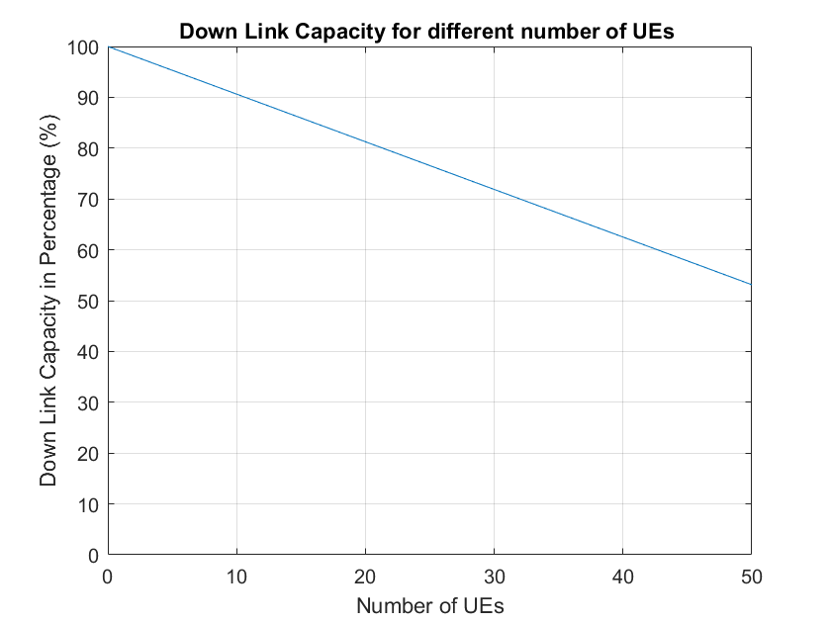
3GPP Baseline
channel capacity for different number of UEs
Notes:
Graph shows the relation between the capacity of cell as the number of users increase. Capacity decreases with increasing users (coz of slots consumed for reports.)

Slide 12
Aim
The thesis aims to find the best machine learning algorithm, by comparing the performance of three ML algorithms and use it to improve the cell capacity in 5G environment.
Notes:
Aim of the thesis is to use best ML algorithm to improve the capacity of the cell in 5G env.

Slide 13
Objective
To find machine learning models and train it to classify the narrow beams accurately.
Compare these models to find the best fit for the problem addressed.
Integrate this model into the 5G simulated environment to further analyse its performance

Slide 14
Research questions
RQ 1. What factors aﬀect the performance of machine learning algorithms?
RQ 2. Which machine learning algorithm outperforms others to ﬁnd the most eﬀective beam?
RQ 3. How much signiﬁcant change is being observed in the measurements of spectrum utilization when using machine learning compared to the baseline algorithm?
Notes:
RQs are framed such that they answer the aim and objectives defined in the study.
RQ1: This research question is answered by performing a Systematic literature review. Multiple factors are responsible for the performance of an algorithm. Using previous researches to list and ﬁgure out most crucial factors in this thesis.
RQ2: This research question is answered by conducting an experiment. Here, three algorithms are considered namely, support vector machines (SVM), k-nearest neighbor (k-NN) and logistic regression (LR). To compare the performance of each algorithm, accuracy is used as a performance matrix. The best performing algorithm is integrated into the simulator.
RQ3: Experiment is conducted to answer this research question. When using machine learning for selecting a narrow beam for the UE , some downlink resources are saved. These resources can be further utilized for data transmission. Improvement in total throughput is evaluated, compared to the baseline algorithm.

Slide 15
Method overview
Data collection using baseline algorithm in simulator
Train and evaluate ML algorithms (from SLR)
Integrate the prediction function for the best algorithm into the simulator
Run simulations and collect KPIs
Notes:
Here we discuss about the overview of the method.
Firstly, we collect the appropriate data using 3gpp algorithm by running simulations.
While conducting SLR, i select the most promising algorithms found, train and evaluate them to find the best algorithm.
Integrate this algo into the simulator and collect the key performing indixes (throughput) and compare it with the baseline algo.

Slide 16
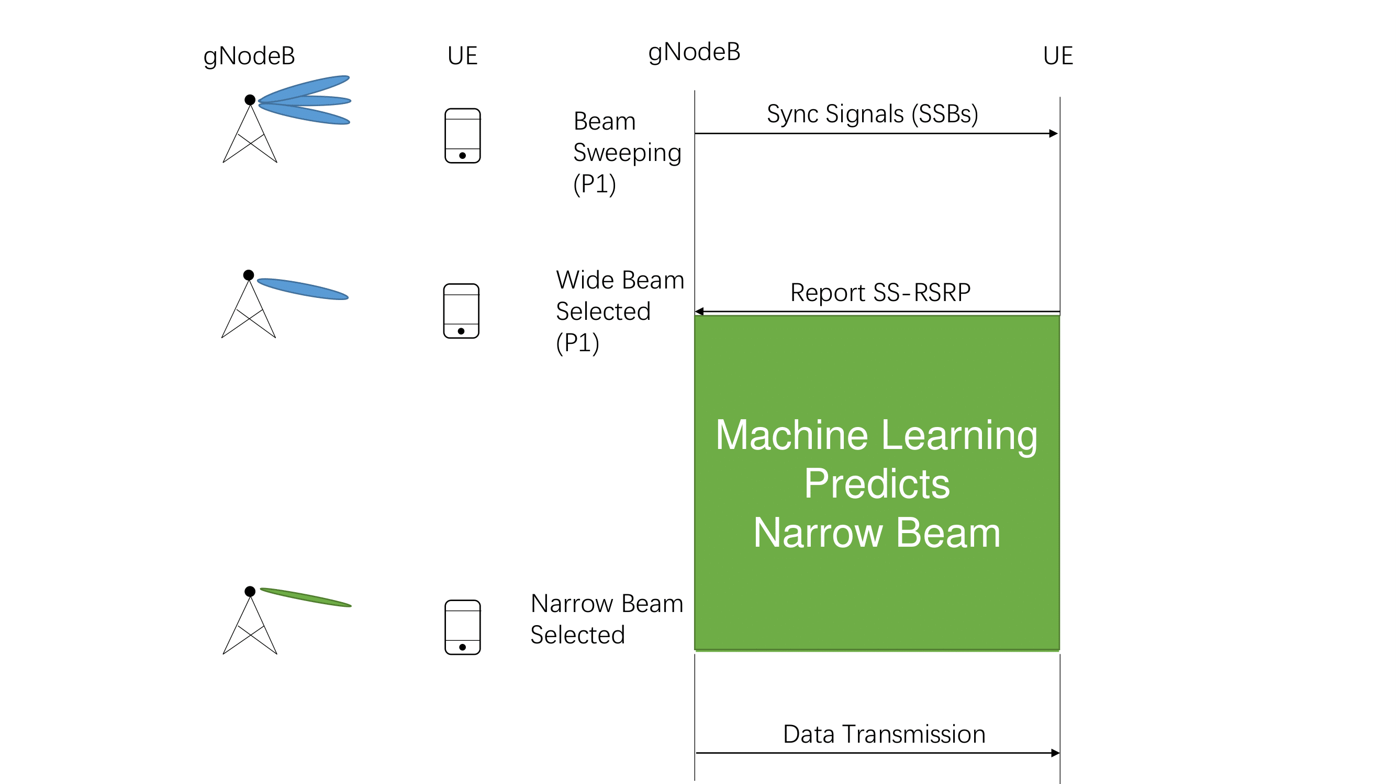
Method
3GPP
Machine learning
Notes:
LHS is 3GPP algo discussed earlier, RHS is our proposed method using machine learning, CSI-RS part is replaced by ML
Our main focus is to replace the reporting process with ML

Slide 17
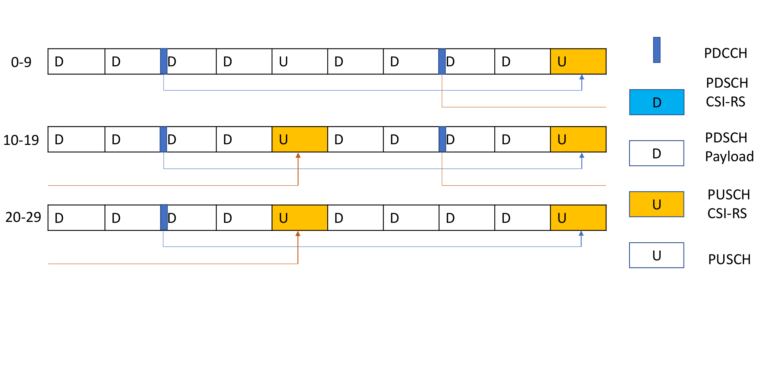
Method
Different reporting intervals (20ms and 40ms)
more frequent prediction for 20ms case.
Free up slots for user data
Notes:
LHS is 3GPP our proposed ML method and RHS is the conceptual TDD pattern for this, where light blue slots are replaced with white slots, meaning they can be used for data transmission.
Here the WB broadcasting can have 2 intervals, 20ms and 40ms, meaning the ML algorithm is used every 20ms or every 40ms.

Slide 18
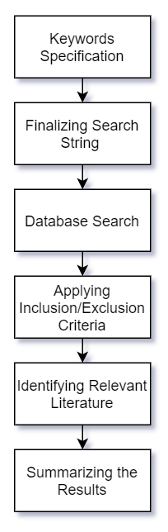
SLR
Notes:
SLR is conducted to list the appropriate articles using the keywords and search strings, which inturn answer the RQ1 and also help in finding the best algorithms used for multiclass classification.

Slide 19
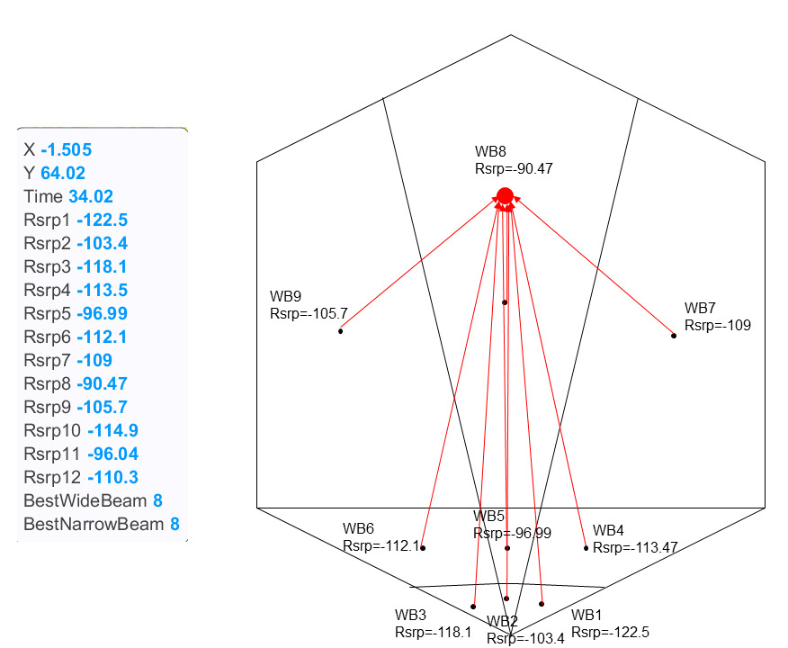
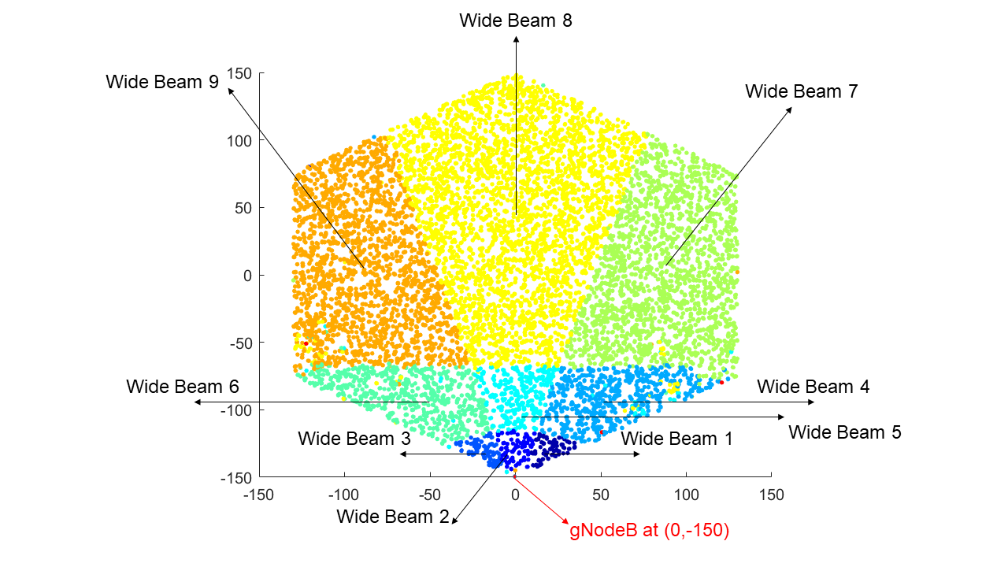
Method: Find data that correlates to Narrow Beams
Training is done for wide beam 8 in the simulator
One model/weights per wide beam
Notes:
The image on the left side, hexagon represents the simulated area, having the base station at (0,-150) where the users are spawned based on which wide beam are they connected to, yellow dots you can see represets the users having wide beam 8 active. I have color coded the wide beams
Dots represents users having the perticular beam as active.
Each wide beam has 12 narrow beams and there are total of 12 wide beams (overlapped) in the simulated environment.
RSRP (Reference Signal Received Power) is power in dbm (decibel-milliwatts)
RHS is the area in which shows if a user is inside wide beam 8, the power received for that beam is more than others. The power decreases as the user goes far from the beam. In this experiment, only wide beam 8 is used (yellow part)

Slide 20
Data collection for training the model
Data is only collected for users having wide beam 8 active.
Necessary logs were enabled in the simulation run.
Simulation configurations are set.
All the UEs having wide beam 8 as active, are logged.
Different seeds are used to gather data.
Notes:
As mentioned all the users having wide beam 8 active are logged
Logs such as Wide beam power (SSB RSRPs) for each beam, distance from the base station and the angle at which user receives a signal.
Simulation config that are number of users = 1, speed = 0, reporting interval, etc
UEs having WB 8 active are logged for the collection of data with different seeds to have a uniform distribution of users.

Slide 21
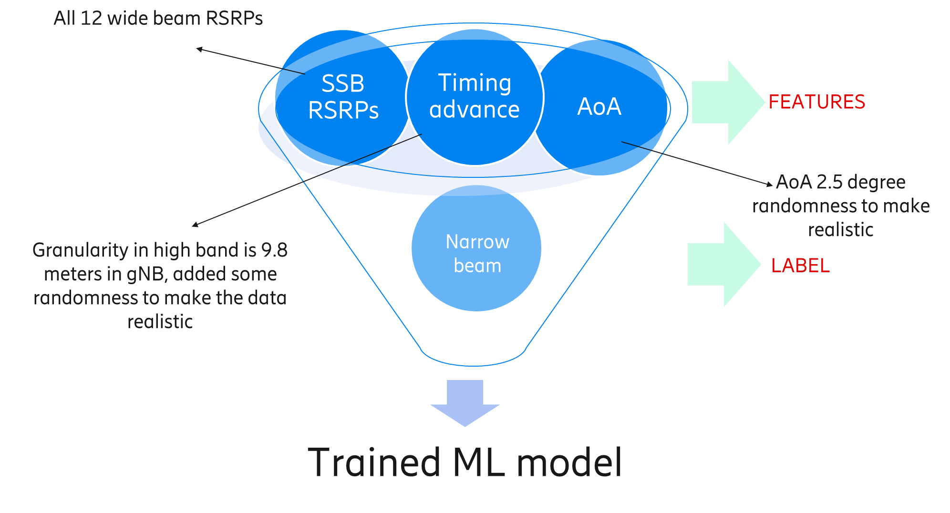
Data description and model
Notes:
The features and labels used in the experiment are shown here, total 12 different wide beam powers plus the distance and the angle of arrival is used to map to a narrow beam. These info are possed by the eah user. Also some randomness is added to the data to make it more realistic.

Slide 22
Training data
More than 60,000 samples collected using 3GPP algorithm.
Using more than 5 different seeds.
User is stationary, when collecting the data.
80% training and 20% testing

Slide 23
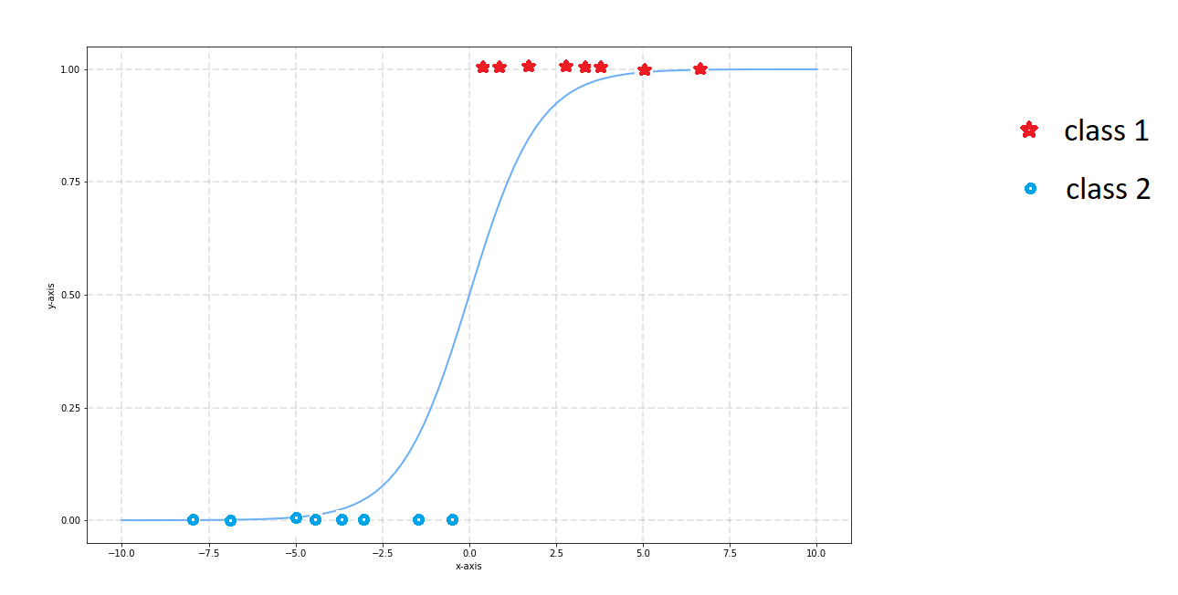
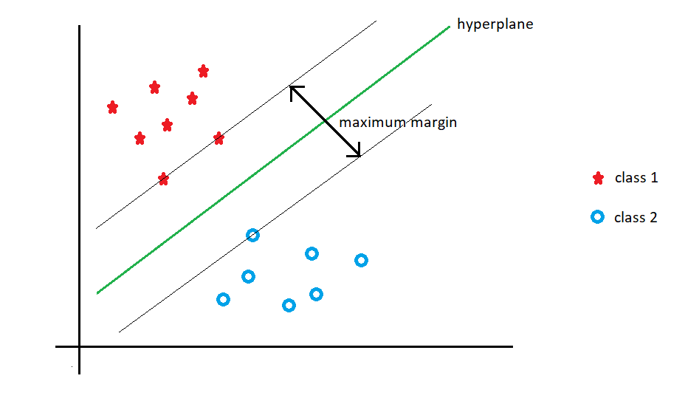
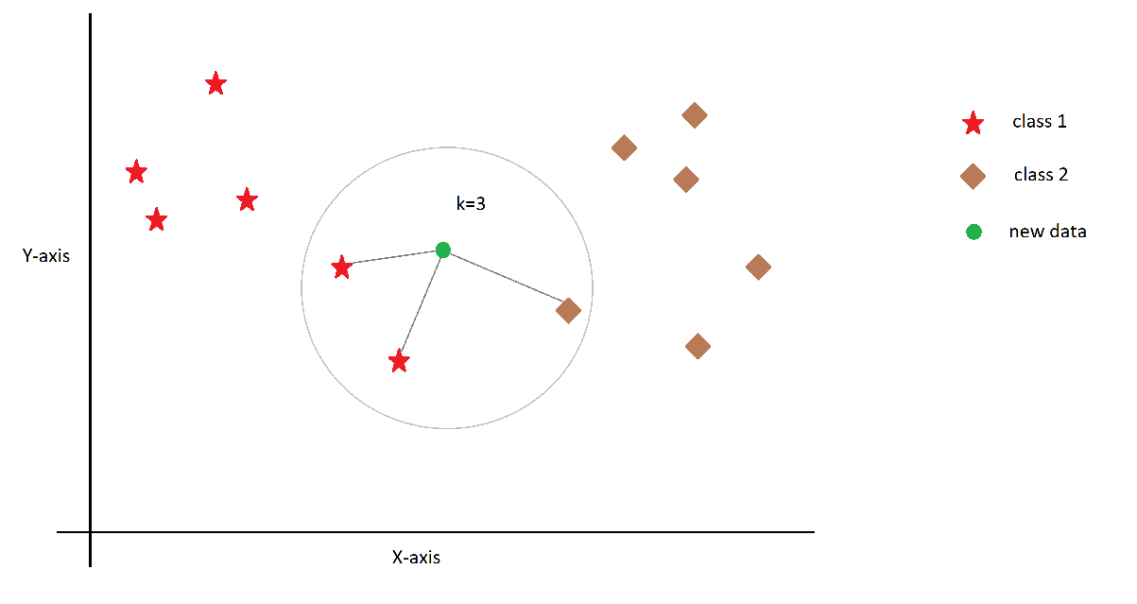
ML Algorithms explored in offline analysis after SLR
Support Vector Machines (SVM)
Accuracy : 79%
Logistic Regression (LR)
Accuracy : 65%
K-Nearest Neighbor (KNN)
Accuracy : 71%
Notes:
These algorithms were found best fit for multiclass classification problem according to SLR conducted. Algorithms are finely tuned to produce the best possible accuracy on this data. We chose SVM.
NN is not chosen for this study because, the dataset is quite large containing more than 60,000 instances and 12 different classes with 14 features each. Hence, it is known that the training of NN will be a time consuming and computationally expensive. And it does not gaurantee significant differnence when compared with SVM algorithm.

Slide 24
10-fold cross validation
 | Average beam accuracy | Neighbor beam
SVM | 75.79% | 18.95%
K-NN | 66.62% | 12.28%
LR | 61.88% | 24.81%
Notes:
Average accuracies for each algorithm is shown after conducting 10 fold cross validation

Slide 25
Simulation
Evaluate the accuracy of the machine learning algorithm
Compare Baseline and SVM Prediction
Testing configs (circular mover is used)
No. of users | Speeds (m/s) | Reporting intervals (ms)
5, 10, 20, 30 and 40 | 1, 5 and 10 | 20 and 40
Limitations
Line of Sight (LoS)
Notes:
Testing the algorithm on various different configurations as mentioned, each simulation is run twice to be able to compare the differences between 3gpp and baseline algorithm. Main limitation of the simulator is LoS.

Slide 26
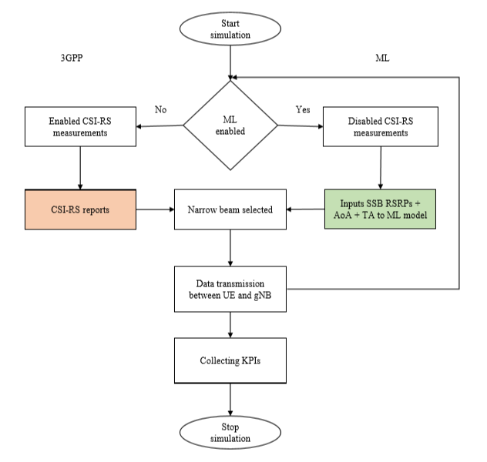
Flow of simulation
Notes:
pointer

Slide 27
SLR results
The amount of training data used for an algorithm.
Features extracted from the data and their relevance.
Quality/cleanness of input data (non-redundant) and tuning of parameters used.
Notes:
Answering RQ1

Slide 28
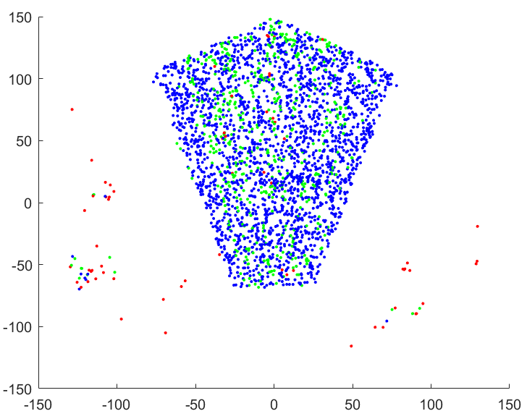
Results: Predicted Narrow Beam vs Baseline (1)
 | SVM
Correct Beam Prediction | 78.3%
Neighbor Beam Prediction | 19.6%
Bad Beam Prediction | 2.1%
Cluster outliers are probably side lobes
Baseline vs SVM (Single UE)
Notes:
SVM algorithm in action inside the simulator.

Slide 29
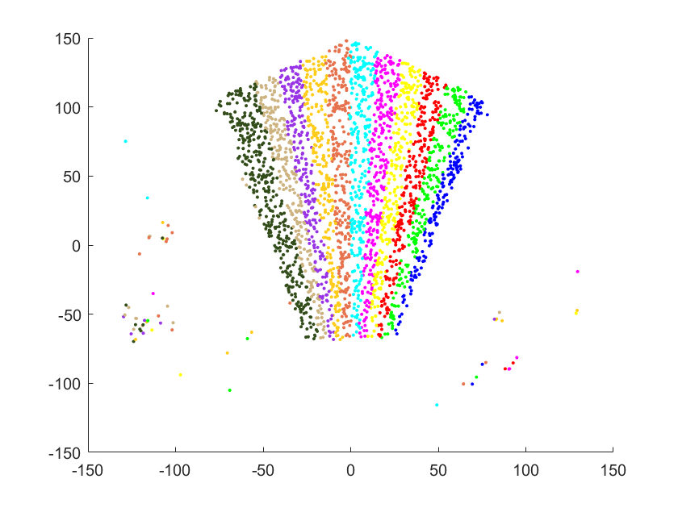
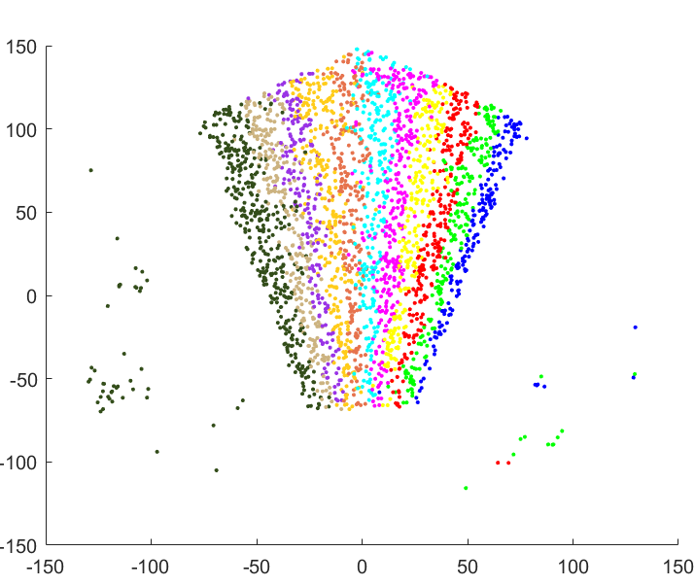
Results: Predicted Narrow Beam vs Baseline (2)
Baseline
SVM
Baseline vs SVM (Single UE)

Slide 30
RSRP distribution inside wide beam
Baseline vs SVM (Single UE)
Notes:
This distribution represents the narrow beam powers on the x-axis and the density in y-axis. Blue is baseline and green is SVM. Both the algorithms perform similarly by SVM a little less accurate, hence lower peak is achieved.

Slide 31
Results: Total throughput for user speed 10m/s (1)
Throughput[Mbps] for SSB 40ms and user speed 10m/s
Notes:
Graph compared the Average throughput [in Mbits/s] for 3GPP and SVM algorithm with speed 10m/s and 40ms interval.

Slide 32
Results: Total throughput for user speed 10m/s (2)
SSB 40ms interval user speed 10m/s
Baseline

Slide 33
Results: Total throughput for SSB interval 20ms (1)
Throughput[Mbps] for SSB 20ms and user speed 10m/s

Slide 34
Results: Total throughput for SSB interval 20ms (2)
SSB 20ms interval user speed 10m/s
Baseline

Slide 35
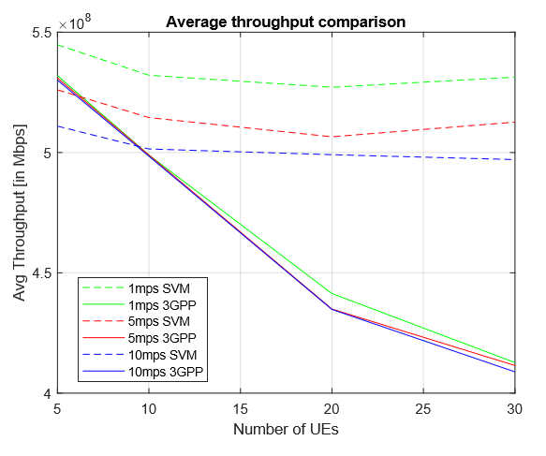
Baseline vs SVM comparison for different number of users and speeds (40ms)

Slide 36
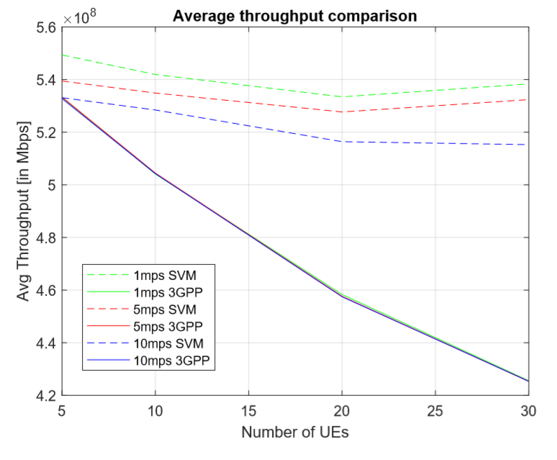
Baseline vs SVM comparison for different number of users and speeds (20ms)

Slide 37


Summary
Increase in average throughput for multiple users.
Better performance at high user speed.
Support for more connected users.
Works well for static environment.
Average throughput less than baseline for less users depending on transmitting conditions.
Model training:
Complex calculations required to be done beforehand
Need to be retrained if channel model changes
(e.g. moving environment, new obstacles)

Slide 38
Future scope
Consider NLOS scenario.
Test for beam reflections.
Figure out way to handle side lobes using ML.
Deep learning algorithms can be used to further enhance the performance.
Train the models using data collected in the field.

Slide 39

Thank you!

